Slide 1
SEMINAR – I
Topic – E-Commerce Delivery System
by Group 4

Slide 2
Branching out
As discussed in the previous week, we have branched the problem into 3 parts:
To formulate the supply demand Matrix.
To find out the most efficient transportation route while supplying from different warehouses.
To develop the last mile distribution in the respective demand points.

Slide 3
Formulation of supply demand matrix using matlab

Slide 4
Objective
Our objective is to solve the demand - supply matrix which will indicate that ith supply point will cater the needs of jth demand point with a quantity of xij.
We have considered the distribution of items(rice, onion, potato, milk and salt) from supply point to different demand points.

Slide 5
12*12 Transportation cost matrix

Slide 6
Capacity of different warehouses (kg)
Warehouse | Salt | Rice | Potato | Onion | Milk
Mukundapur | 9,801 | 1,34,250 | 1,09,190 | 22,375 | 1,61,995
Jadavpur 8B | 4,841 | 66,303 | 53,926 | 11,050 | 80,005
Ballygunje | 9,595 | 1,31,423 | 1,06,890 | 21,904 | 1,58,582
Tollygunje | 10,330 | 1,41,510 | 1,15,094 | 23,584 | 1,70,755
Overall | 10,330 | 4,73,486 | 3,85,100 | 78,913 | 5,71,337

Slide 7
Minimum demand of different locations
Sl. No. | Location | Total salt demand in a day | Total rice demand in a day | Total potato demand in a day | Total Onion consumption per day | Total Milk consumption per day
 |  | kg/day | kg/day | kg/day | kg/day | kg/day
1 | Jadavpur 8B | 3,636 | 49,803 | 40,506 | 8,300 | 60,095
2 | Nayabad | 1,150 | 15,750 | 12,810 | 2,625 | 19,005
3 | Garia | 6,023 | 82,500 | 67,100 | 13,750 | 99,550
4 | South City | 1,205 | 16,500 | 13,420 | 2,750 | 19,910
5 | Gariahat | 2,738 | 37,500 | 30,500 | 6,250 | 45,250
6 | Ballygunje | 2,886 | 39,532 | 32,152 | 6,589 | 47,701
7 | Ruby Hospital | 1,259 | 17,250 | 14,030 | 2,875 | 20,815
8 | VIP Bazzar | 1,314 | 18,000 | 14,640 | 3,000 | 21,720
9 | Behala | 7,099 | 97,251 | 79,097 | 16,208 | 1,17,349
10 | Tollygunje | 3,231 | 44,259 | 35,997 | 7,376 | 53,406
11 | Bhawanipur | 2,657 | 36,391 | 29,598 | 6,065 | 43,911
12 | Mukundapur | 1,369 | 18,750 | 15,250 | 3,125 | 22,625
Total |  | 34,564 | 4,73,484 | 3,85,101 | 78,914 | 5,71,338

Slide 8
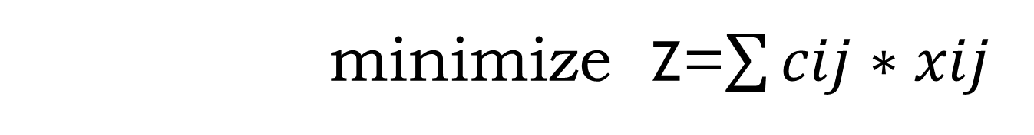
1. Objective function for Rice
minimize Z=$\sum{cij∗xij}$
Where, cij is the transportation cost from ith supply point to the jth demand point
xij is the unit of rice transported from ith supply point to the jth demand point

Slide 9
Constraints
Constraint 1 : With respect to maximum supply capacity of each warehouse:
x11 + x12 + x13 + x14 + x15 + x16 + x17 + x18 + x 19 + x110 + x 111 + x112 <= 1,35,000 ( Mukundapur)
x21 + x22 + x23 + x24 + x25 + x26 + x27 + x28 + x29 + x210 + x 211 + x212 <= 67,000 ( Jadavpur)
x31 + x32 + x33 + x34 + x35 + x36 + x37 + x38 + x39 + x310 + x 311 + x312 <= 1,32,000 (Ballygunje)
x41 + x42 + x43 + x44 + x45 + x46 + x47 + x48 + x49 + x410 + x 411 + x412 <= 1,42,000 ( Tollygunje)

Slide 10
Constraints
Constraint 2 : With respect to minimum demand at different locations:
x11 + x21 + x31 + x41 >= 18,750 ( Mukundapur)
x12 + x22 + x32 + x42 >= 49,803 ( Jadavpur)
x13 + x23 + x33 + x43 >= 15750 ( Nayabad)
x14 + x24 + x34 + x44 >= 82500 ( Garia)
x15 + x25 + x35 + x45 >= 16500 ( South City)
x16 + x26 + x36 + x46 >= 37500 ( Gariahat)
x17 + x27 + x37 + x47 >= 39532 ( Ballygunje)
x18 + x28 + x38 + x48 >= 17250 ( Ruby Hospital)
ix) x19 + x29 + x39 + x49 >= 18,000 ( VIP Bazzar)
x110 + x210 + x310 + x410 >= 97,251 ( Behala)
x111 + x211 + x311 + x411 >= 44,259 ( Tollygunje)
x112 + x212 + x312 + x412 >= 36,391 ( Bhowanipore)

Slide 11
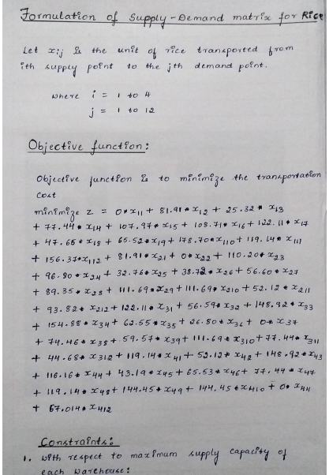
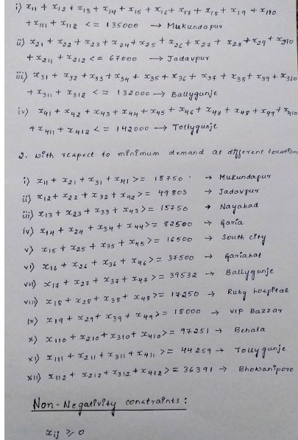
Mathematics involved in formulation

Slide 12
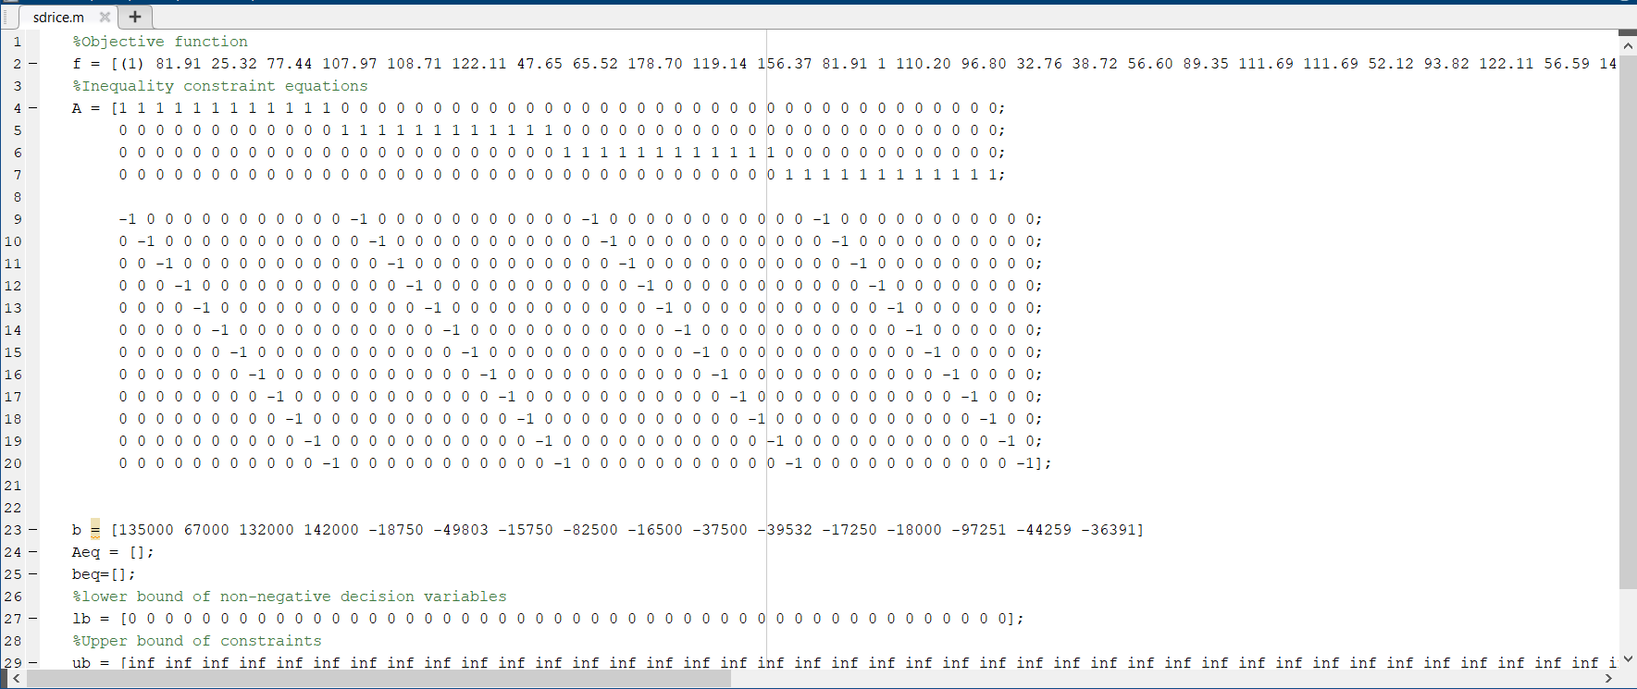
Matlab code for Rice

Slide 13
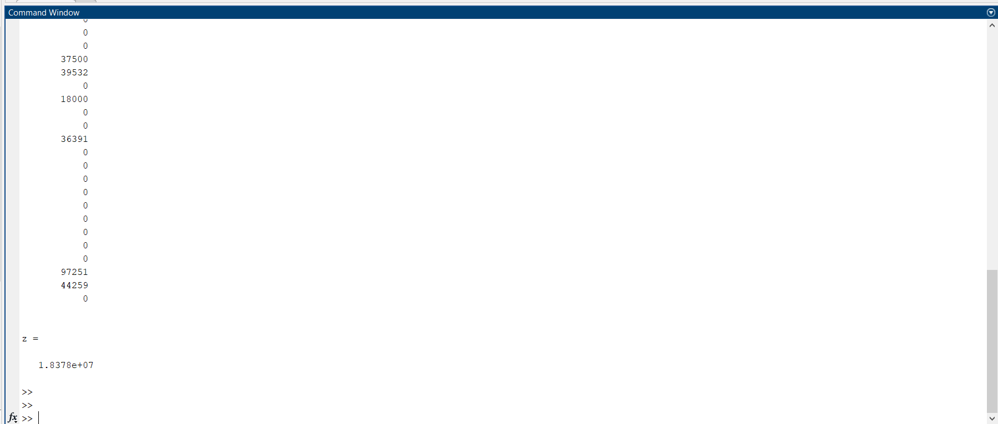
Result

Slide 14
Inference
From | Mukundapur | Jadavpur 8B | Nayabad | Garia | South City | Gariahat | Ballygunje | Ruby Hospital | VIP Bazzar | Behala | Tollygunje | Bhawanipur | Total Supply
Mukundapur | 18750 | 0 | 15750 | 82500 | 0 | 0 | 0 | 17250 | 0 | 0 | 0 | 0 | 134250
Jadavpur | 0 | 49803 | 0 | 0 | 16500 | 0 | 0 | 0 | 0 | 0 | 0 | 0 | 66303
Ballyganje | 0 | 0 | 0 | 0 | 0 | 37500 | 39532 | 0 | 18000 | 0 | 0 | 36391 | 131423
Tollygunje | 0 | 0 | 0 | 0 | 0 | 0 | 0 | 0 | 0 | 97251 | 44259 | 0 | 141510
Total Demand | 18750 | 49803 | 15750 | 82500 | 16500 | 37500 | 39532 | 17250 | 18000 | 97251 | 44259 | 36391

Slide 15
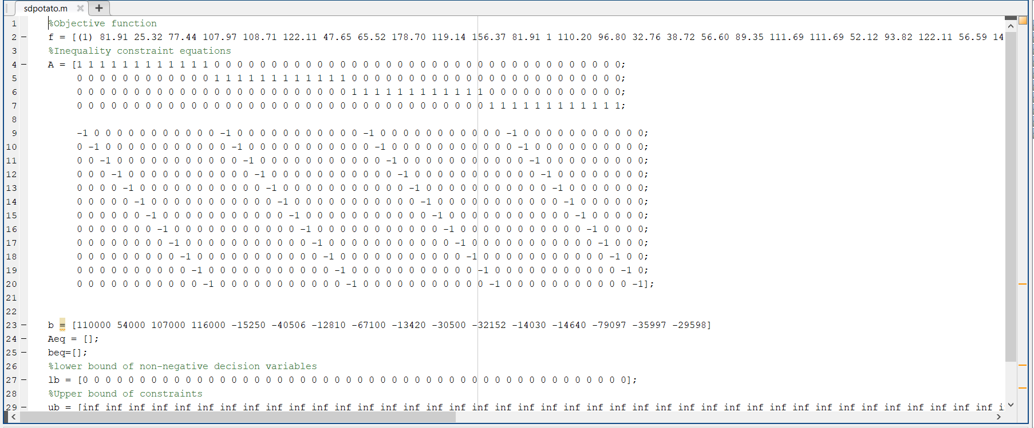
Matlab code for Potato

Slide 16
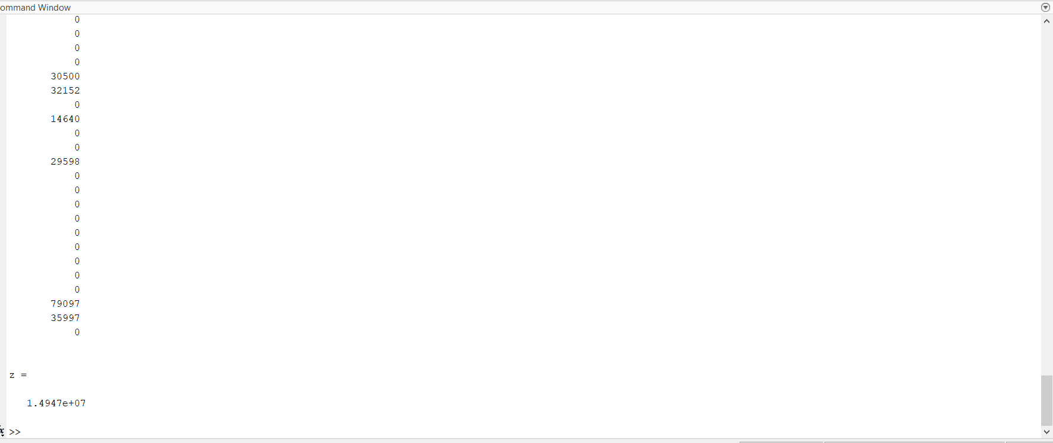
Result

Slide 17
Inference
From | Mukundapur | Jadavpur 8B | Nayabad | Garia | South City | Gariahat | Ballygunje | Ruby Hospital | VIP Bazzar | Behala | Tollygunje | Bhawanipur | Total Supply
Mukundapur | 15250 | 0 | 12810 | 67100 | 0 | 0 | 0 | 14030 | 0 | 0 | 0 | 0 | 109190
Jadavpur | 0 | 40506 | 0 | 0 | 13420 | 0 | 0 | 0 | 0 | 0 | 0 | 0 | 53926
Ballyganje | 0 | 0 | 0 | 0 | 0 | 30500 | 32152 | 0 | 14640 | 0 | 0 | 29598 | 106890
Tollygunje | 0 | 0 | 0 | 0 | 0 | 0 | 0 | 0 | 0 | 79097 | 35997 | 0 | 115094
Total Demand | 15250 | 40506 | 12810 | 67100 | 13420 | 30500 | 32152 | 14030 | 14640 | 79097 | 35997 | 29598

Slide 18
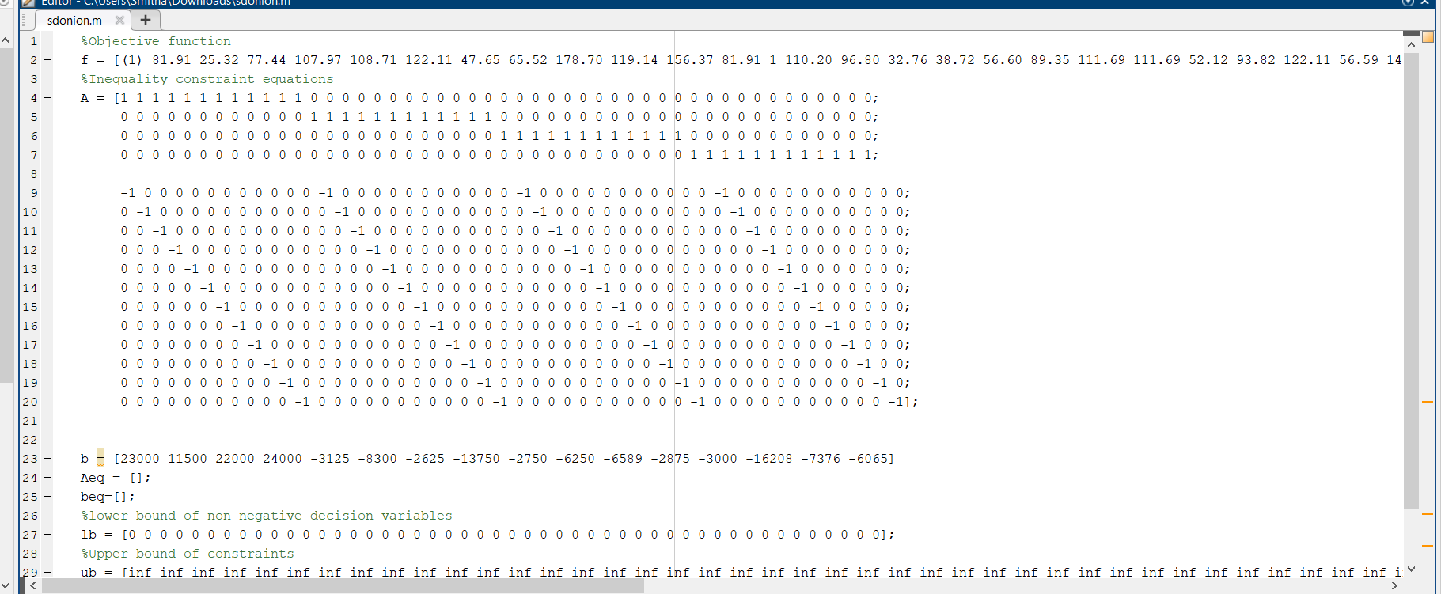
Matlab code for Onion

Slide 19
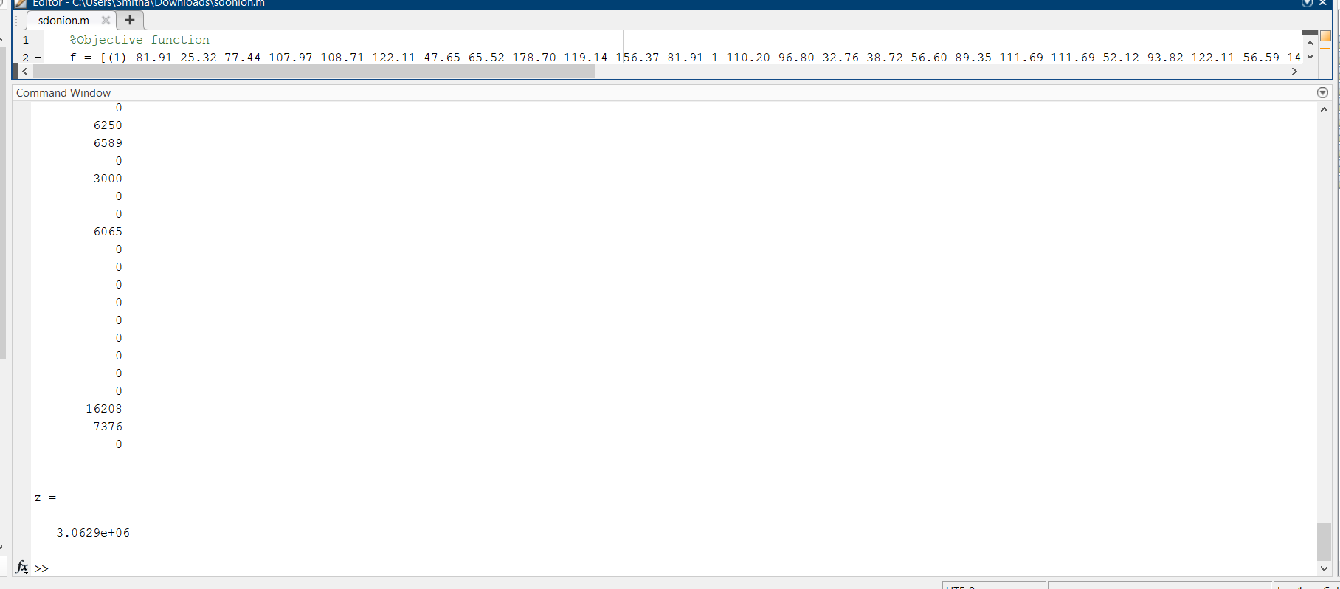
Result

Slide 20
Inference
From | Mukundapur | Jadavpur 8B | Nayabad | Garia | South City | Gariahat | Ballygunje | Ruby Hospital | VIP Bazzar | Behala | Tollygunje | Bhawanipur | Total Supply
Mukundapur | 3125 | 0 | 2625 | 13750 | 0 | 0 | 0 | 2875 | 0 | 0 | 0 | 0 | 22375
Jadavpur | 0 | 8300 | 0 | 0 | 2750 | 0 | 0 | 0 | 0 | 0 | 0 | 0 | 11050
Ballyganje | 0 | 0 | 0 | 0 | 0 | 6250 | 6589 | 0 | 3000 | 0 | 0 | 6065 | 21904
Tollygunje | 0 | 0 | 0 | 0 | 0 | 0 | 0 | 0 | 0 | 16208 | 7376 | 0 | 23584
Total Demand | 3125 | 8300 | 2625 | 13750 | 2750 | 6250 | 6589 | 2875 | 3000 | 16208 | 7376 | 6065

Slide 21
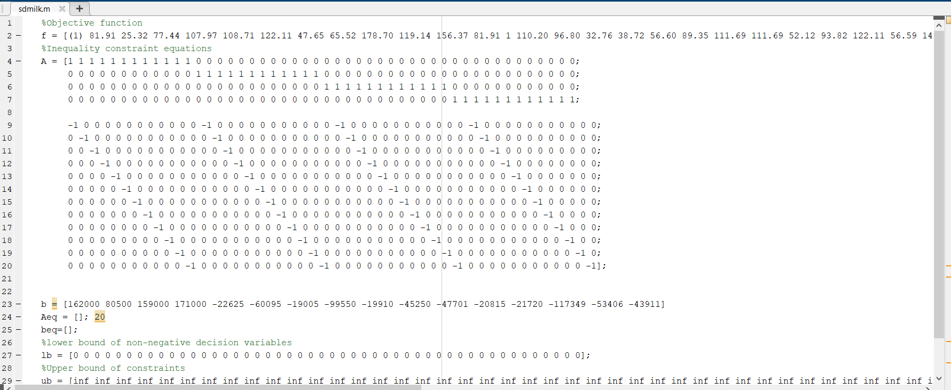
Matlab code for Milk

Slide 22
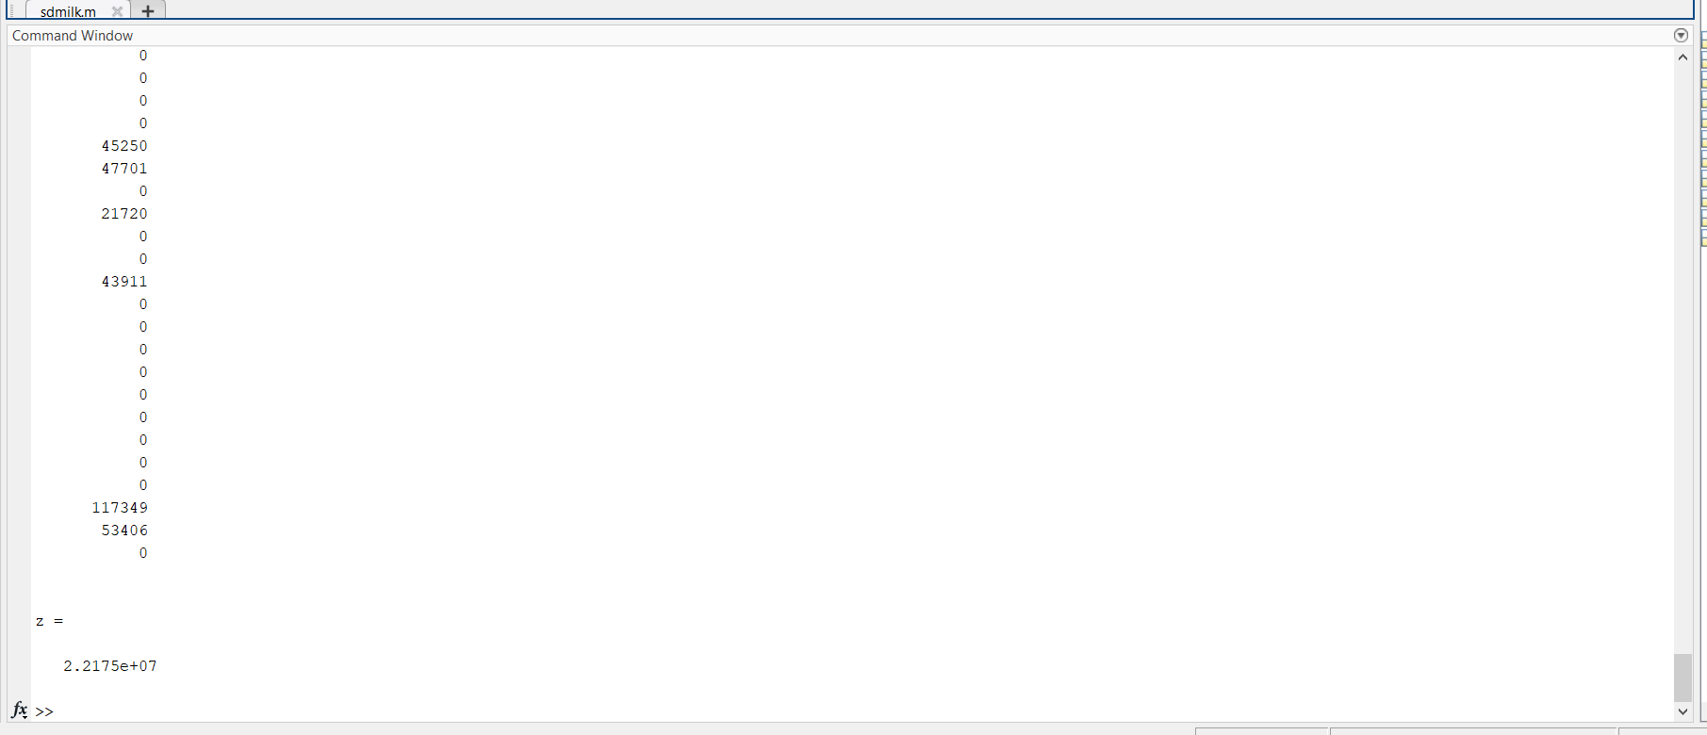
Result

Slide 23
Inference
From | Mukundapur | Jadavpur 8B | Nayabad | Garia | South City | Gariahat | Ballygunje | Ruby Hospital | VIP Bazzar | Behala | Tollygunje | Bhawanipur | Total Supply
Mukundapur | 22625 | 0 | 19005 | 99550 | 0 | 0 | 0 | 20815 | 0 | 0 | 0 | 0 | 161995
Jadavpur | 0 | 60095 | 0 | 0 | 19910 | 0 | 0 | 0 | 0 | 0 | 0 | 0 | 80005
Ballyganje | 0 | 0 | 0 | 0 | 0 | 45250 | 47701 | 0 | 21720 | 0 | 0 | 43911 | 158582
Tollygunje | 0 | 0 | 0 | 0 | 0 | 0 | 0 | 0 | 0 | 117349 | 53406 | 0 | 170755
Total Demand | 22625 | 60095 | 19005 | 99550 | 19910 | 45250 | 47701 | 20815 | 21720 | 117349 | 53406 | 43911

Slide 24
Formulation of route matrix using matlab

Slide 25
Problem Statement
As per the output of Demand – Supply matrix, we need to supply the goods from the 4 warehouses to 12 demand points.
We are planning to use the heavy tonnage trucks for this movement.
Find out the optimal route for the truck movement.

Slide 26
Objective
Using the data from 12 x 12 cost matrix we need to find out the optimal route for the truck.
Optimum route => Minimum Transportation cost
Objective: Minimize the cost for Transportation
We have solved this using Matlab.

Slide 27
Constraints
There are two main constraints:
1. Sequence of the Movement:
There is no multiple movements from single source.
2. Connect all the demand points:
The route must be designed to connect all the demand points.

Slide 28
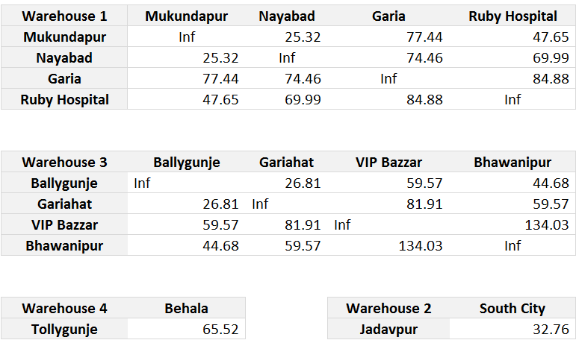
Transportation Cost Matrix

Slide 29
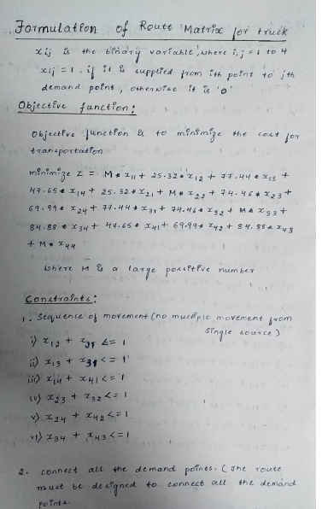
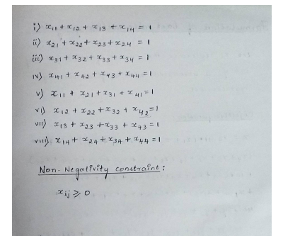
Mathematics involved in formulation

Slide 30
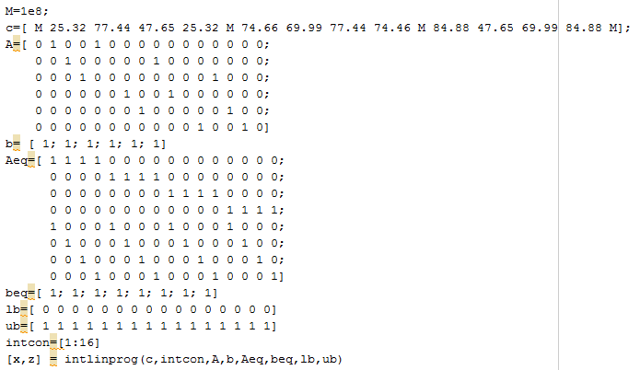
MATLAB CODE - 1

Slide 31
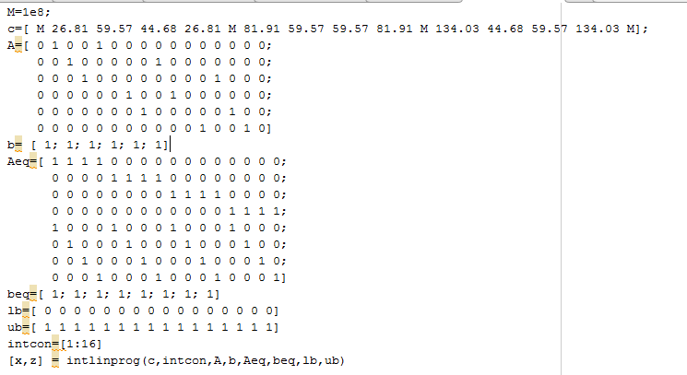
MATLAB CODE - 2

Slide 32
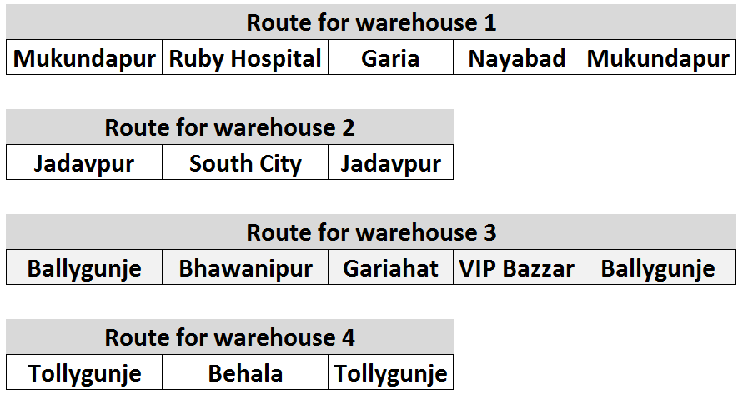
RESULTS

Slide 33
Formulation of last mile delivery system matrix using cplex

Slide 34
Our Next Step
As of now, we have obtained the optimal route from source to demand points.
Next, we have to find out the efficient way of last mile delivery system within the demand point using Mixed Model Transportation such as Vans, Bicycles and Drones.
If possible by walking!!

Slide 35
Last-Mile-delivery
We have four items, which are to be delivered to the respective door step which are in 1km radius of the stoppage point of the big truck.
The truck will move from a particular ware-house to the demand points four times in a day.
Therefore each item to be distributed in 45 minutes per demand point.

Slide 36
Sample problem
In this case we have taken a sample problem to understand the most appropriate last mile delivery system.
Here we have considered the daily rice demand of Mukundapur region
We have solved another linear programming model to understand this system.

Slide 37
OBJECTIVE FUNCTION
We have used 5 vans, 10 bikes, 10 bicycles and 4 drones.
Xi represents the number of trip per day and yi is associated with the fixed per day operator cost.
z = 12.41*(x1 + x2 + x3 + x31 + x32) + 13.756*(x4 + x5 + x6 + x7 + x8 + x81 + x82 + x83 + x84 + x85) + 10*(x9 + x10 + x11 + x12 + x13 + x131 + x132 + x133 + x134 + x135 ) + 10*(x14 + x15 + x16 + x17) +
400*(y1 + y2 + y3 + y31 + y32) + 333.33*(y4 + y5 + y6 + y7 + y8 + y81 + y82 + y83 + y84 + y85) + 266.67*(y9 + y10 + y11 + y12 + y13 + y131 + y132 + y133 + y134 + y135) + 266.67*(y14 + y15 + y16 + y17) ;

Slide 38
RESULTS
Cars:
x1 = 6; x2 = 6;x3 = 4;x31 = 4;x32 = 6;
Bikes:
x4 = 6;x5 = 6;x6 = 6;x7 = 6;x8 = 1;
x81 = 0;x82 = 0;x83 = 0;x84 = 0;x85 = 0;
Bicycles:
x9 = 0;x10 = 0;x11 = 0;x12 = 0;x13 = 0;
x131 = 0;x132 = 0;x133 = 0;x134 = 0;x135 = 0;
Drones:
x14 = 0;x15 = 0;x16 = 0;x17 = 0;

Slide 39
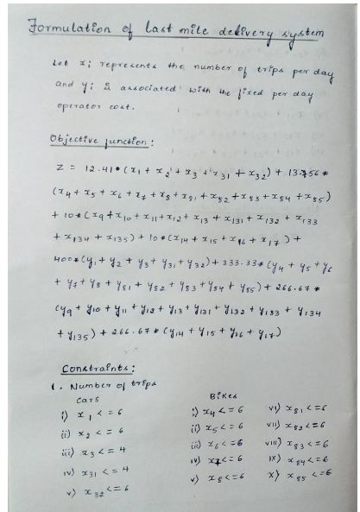
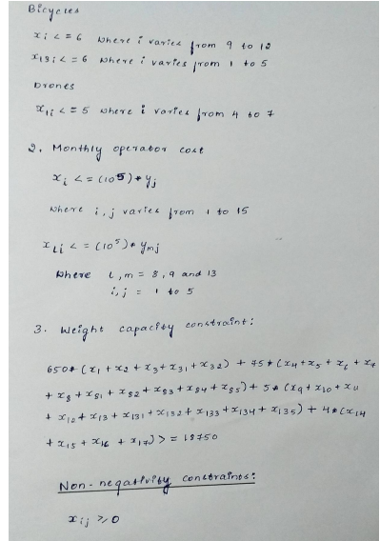
Mathematics involved in formulation

Slide 40
INFERENCE OF RESULTS
Here we have again seen that only vans and bikes are sufficient to distribute the last-mile delivery of items.
Therefore with this situation of high weight requirement, we have seen that neither drones nor bicycles are useful.

Slide 41
Next step
We will formulate the complete vehicle-trip distribution system for entire south-Kolkata which includes all the 12 demand points.
Apart from the regular heavy items, we will try to design the delivery of emergency items such as medicines through a quick and cost efficient model.

Slide 42
Last mile delivery of rice

Slide 43
Last mile delivery of potato

Slide 44
Last mile delivery of onion

Slide 45
Last mile delivery of MILK

Slide 46
Assumption we made while solving the problem
The roads will be empty due to lockdown situation prevailing in the city.
The big truck will move from a particular ware-house and distribute the items in respective demand points in 12 hours shift.
Therefore each item will get 3 hours time be distributed that is the truck will go for 4 rounds in 12 hours.

Slide 47
conclusion
We have tried to solve the above transportation problem in current lockdown situation using various optimisation concepts and the results are displayed above
We are considering bulk orders for items of Rice, Potato, Onion and Milk so the delivery charges will not be charged for any orders.
Drones and bicycles were not required at any point of time for the considered items.

Slide 48
Delivery of emergency item (medicines)
In the above part we have modelled the delivery of regular items.
In the upcoming part we have tried to capture the delivery of emergency item such as medicines through our already existing model.

Slide 49
Formation of the problem
We have assumed at max 2 bikes, 5 bicycles and 5 drones working 24*7 for delivery of medicines while working in shifts.
There are two ways to look in the problem:
Optimal Cost Condition
Minimum Time Consumption
We have solved the problem from both the perspective considering Mukundapur and Behala as our test region.

Slide 50
Problem formulation
Objective Function:
Minimize z = 15*x1 + 11*(x4 + x5 + x6 + x7 + x8) + 10*(x9 + x10 + x11 + x12 + x13)+
500*y1 + 333.33*(y4 + y5 + y6 + y7 + y8) + 400*(y9 + y10 + y11 + y12 + y13);
Where:
Xi = No. of units transportad y a particular type of vehicle,
i.e. x1 for bikes, x4 to x8 for bicycles and from x9 to x13 for drones.
Yi = It is related to the monthly operator cost of a particilar vehicle converted to per day cost.

Slide 51
Constraints
The maximum number of trips restricted to:
x1<=1;
The maximum number of trips for bicycles
x4<=5;
The maximum number of trips for drones
x11<=5;
Related Fixed Cost Constraints of bikes, bicycles and drones are:
x1<=(10^6)*y1
x4<=(10^6)*y4
x9<=(10^6)*y9;
Load capacity constraint:
75*x1 + 5*(x4 + x5 + x6 + x7 + x8) + 4*(x9 + x10 + x11 + x12 + x13) >=113;

Slide 52
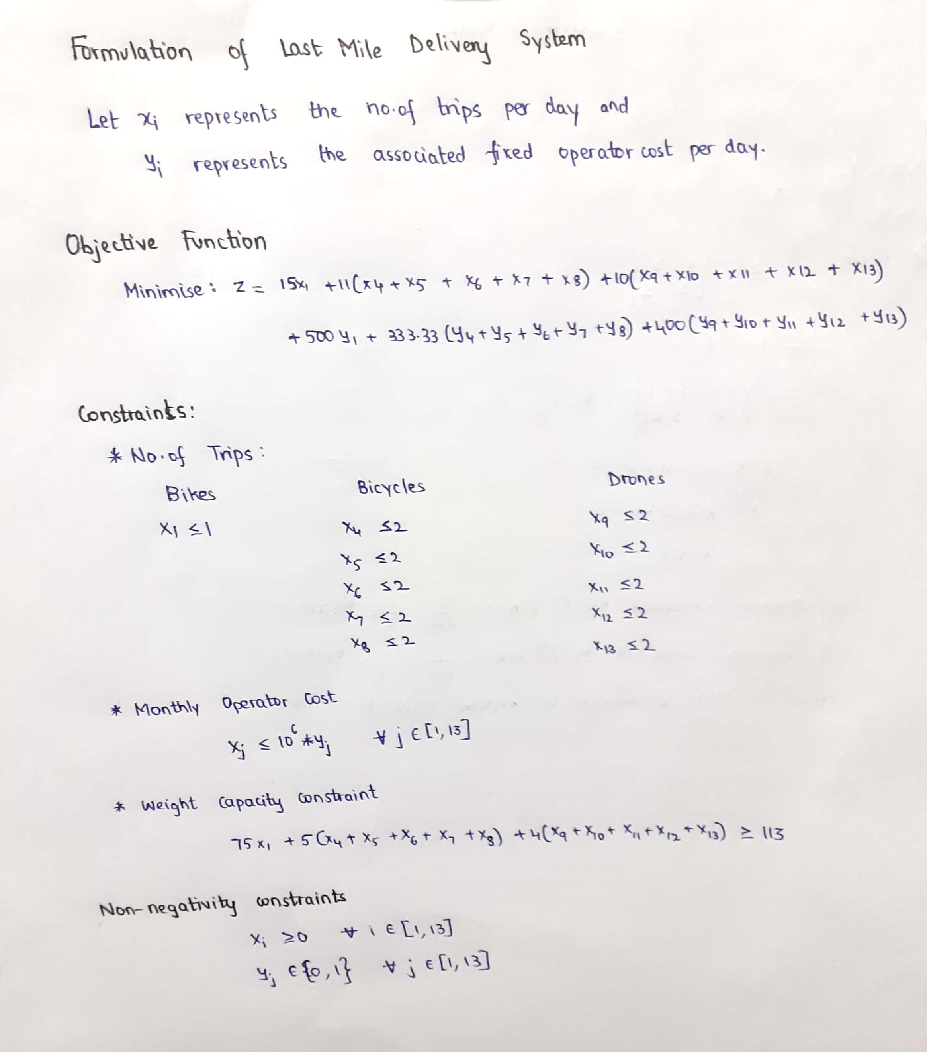
Mathematics involved in formulation

Slide 53
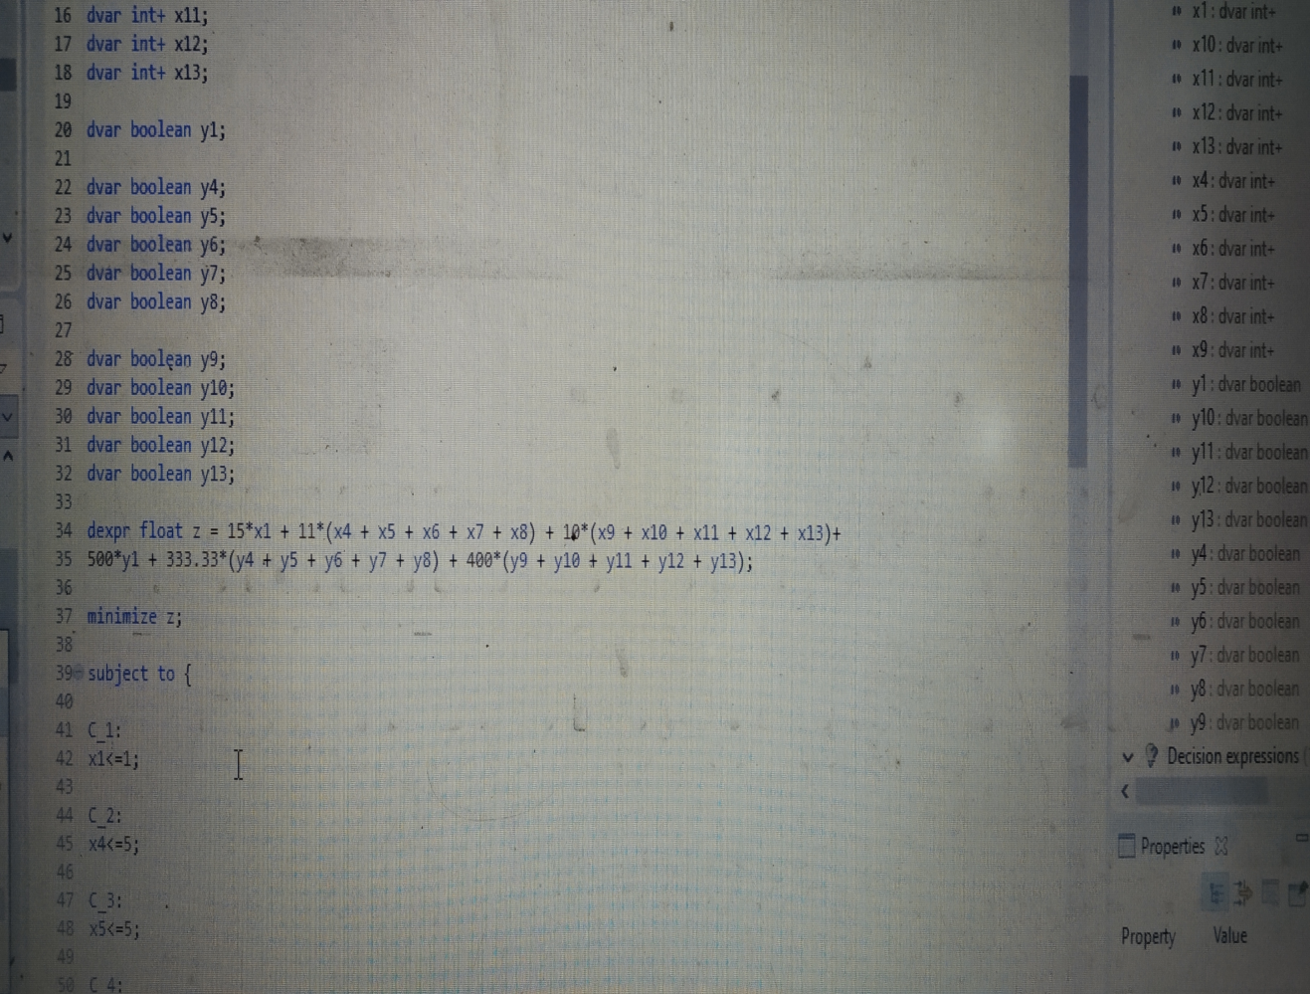
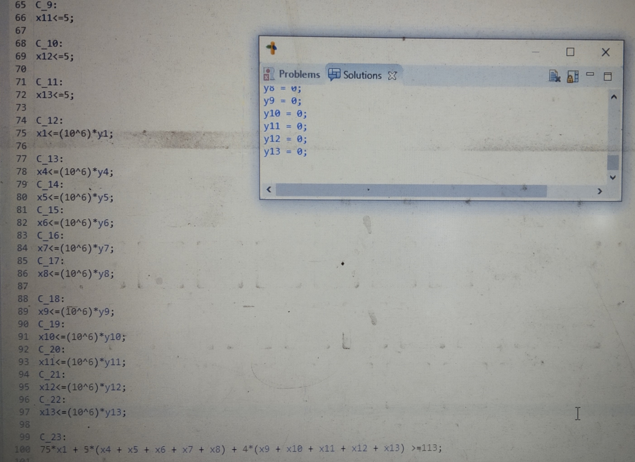
CPLEx code

Slide 54
Inference of results
For Mukundapur region, we need:
1 Bike undergoing 1 trip per day
2 Bicycle undergoing 5 and 3 trips per day.
No drones required
Similarly for Behala region (6 lakhs population), we need:
2 Bikes undergoing 3 trips per day
2 bicycles undergoing 4 trips a day
3 bicycles undergoing 5 trips a day
1 drone undergoing 5 trips a day

Slide 55
Problems faced in the above results
The results obtained are cost effective results which shows only few vehicles going for more number of trips.
But as we are modelling in a pandemic situation, if we give our preference to timely delivery, we need to have more number of vehicles to cater the need whenever the demand arises.
We have tried to form a table which serves the need of all the 12 demand points considering minimum time consumption criteria.

Slide 56
TIME optimization perspective
Here we have proposed to have all kinds of vehicles to be present at all the demand points.
The number of each vehicle present will depend on the total demand at that location.
During peak hours of high demand we can have the bikes and bicycles doing the needful.
While in case of emergency and quick requirements, drones will solve the purpose.

Slide 57
TIME optimization perspective

Slide 58
Final conclusion
In case of emergency demand problem, as we have not solved the problem optimally, our cost incurred for delivery will be quiet high.
Therefore we can conclude with two results:
Regular item will be ordered in bulk and for that no extra delivery charge will be taken from customers.
Emergency items can be can be delivered on time but a certain percentage of cost will be charged to customers depending on the market price and profit margin expectations of the company.

Slide 59
Thank you

